Slide 1
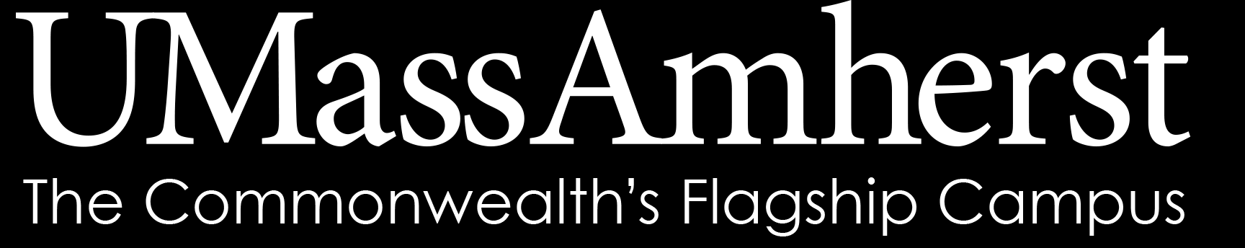
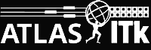
Title Slide
Pixel Inner System
Cooling
Rafael Coelho Lopes de Sa
Anirudh J. Uppal
US-ATLAS ITk Pixel Inner System Meeting
Apr 27th 2020

Slide 2
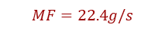
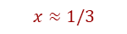
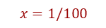

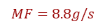
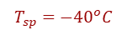
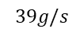

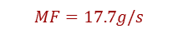
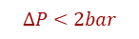
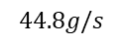
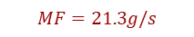
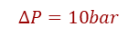
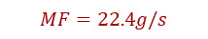
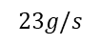
Summary of cooling strategy
$$MF=2.7g/s$$
(x2)
$$23g/s$$
$$MF=8.8g/s$$
$$MF=2.7g/s$$
$$MF=8.8g/s$$
$$MF=22.4g/s$$
Q1
Boundary conditions
$$44.8g/s$$
$$MF=22.4g/s$$
Q2
warm nose
capillary
$$x=1/100$$
$$MF=21.3g/s$$
$$39g/s$$
Q3
$$ΔP=10bar$$
$$x≈1/3$$
flex (??)
exhaust
evaporator
$$MF=17.7g/s$$
Q4
$$T_{sp}=−{40}^{o}C$$
Q4 has the PixLumi and BCM’ rings which are not counted here (because I have no idea how much power they use)
$$ΔP<2bar$$

Slide 3
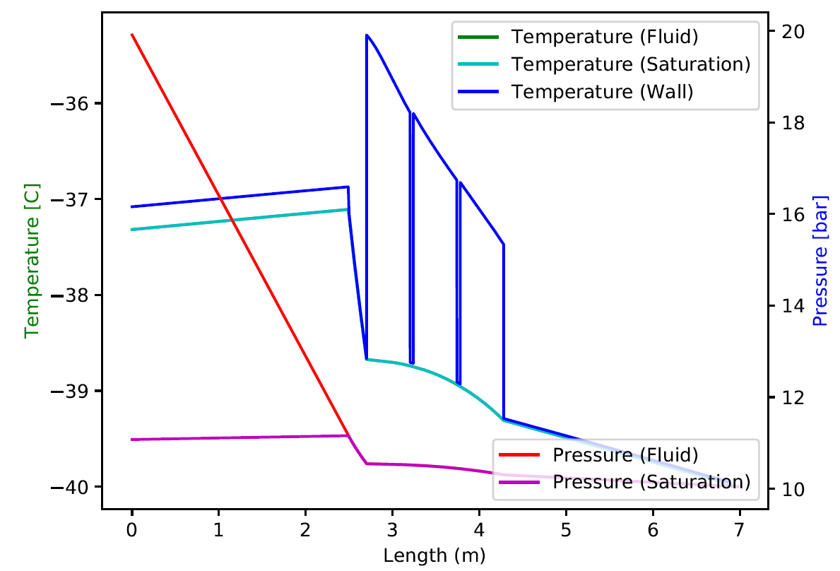
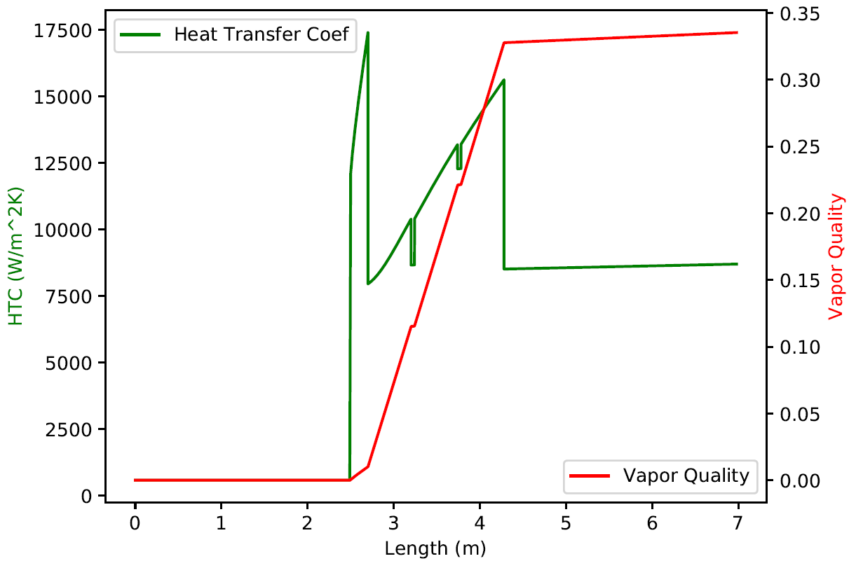
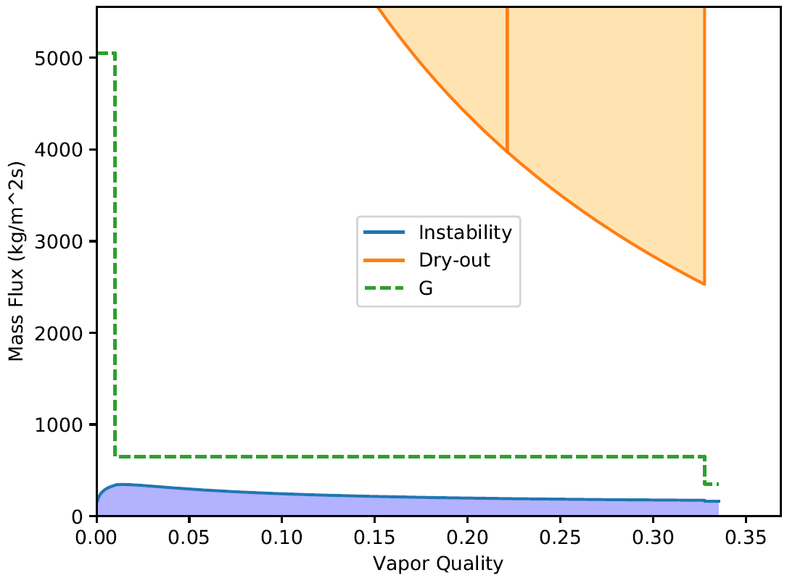
Barrel L0
Using and exhaust tube with ID = 3mm. Evaporator with ID = 2.3mm. Capillary with 2.7m
Should fit well in the tray.
Heat dissipation to most recent recommendations [FE (0.8)+ sensor (0.041)+ services (0.092)]
Result: capillary ID = 0.820mm

Slide 4
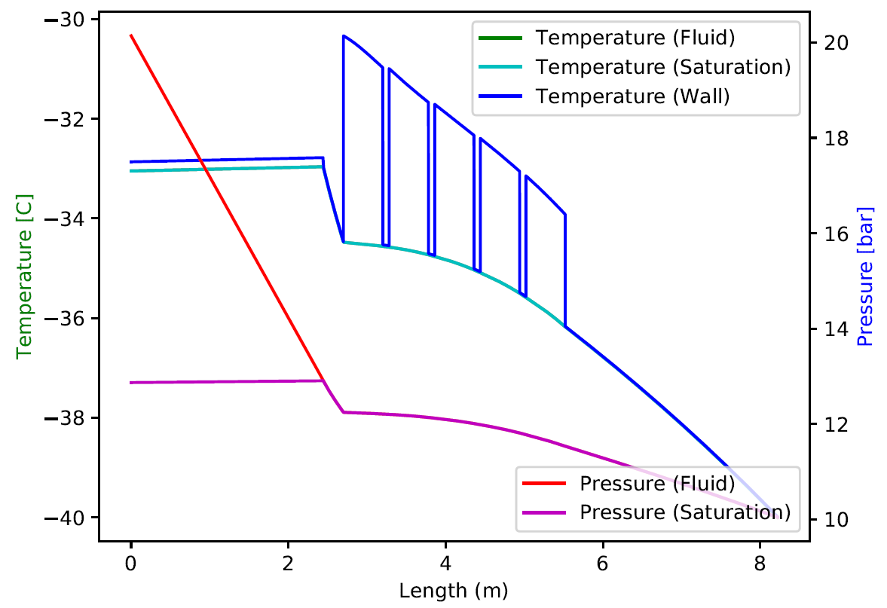
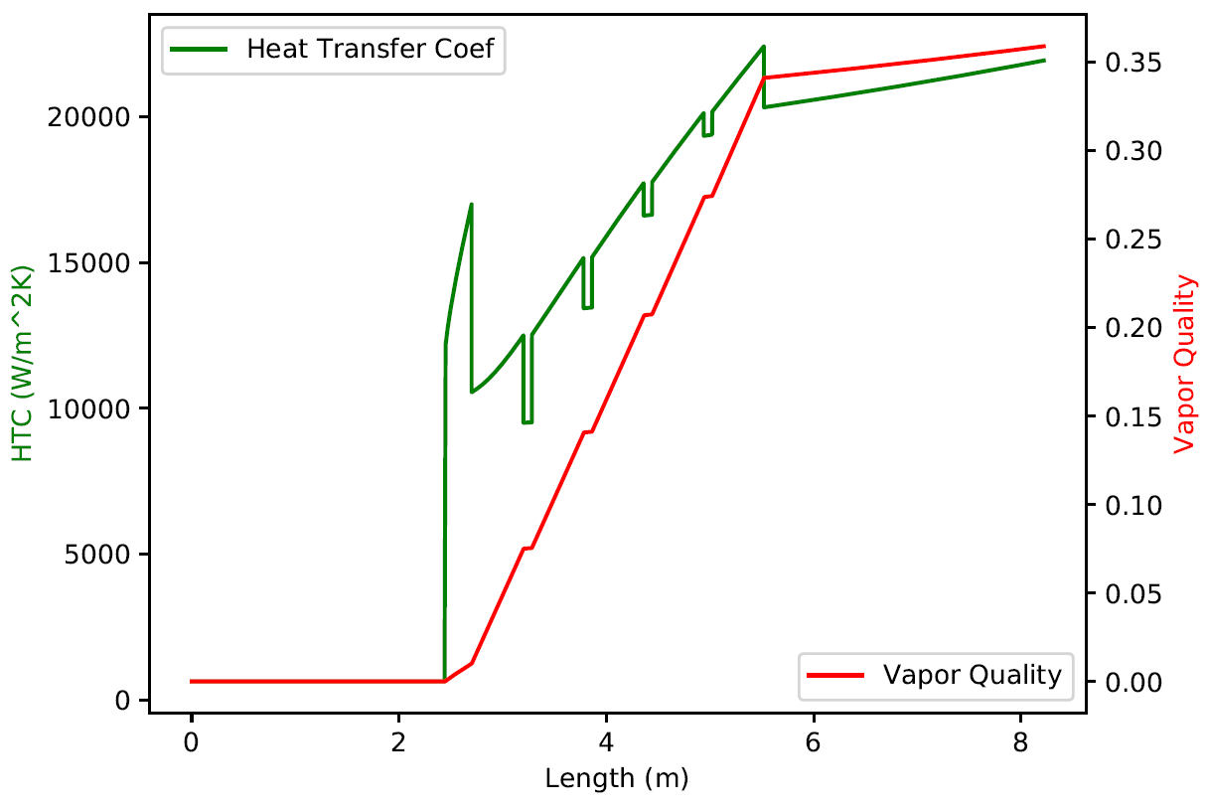
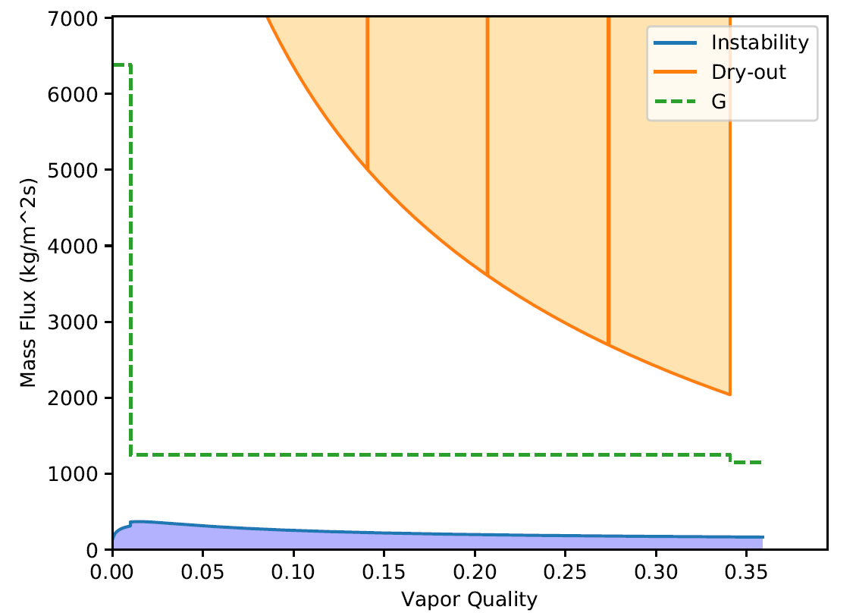
Barrel L1
Using and exhaust tube with ID = 3mm. Evaporator with ID = 3mm. Capillary with 2.7m
Heat dissipation to most recent recommendations [FE (0.8) + sensor (0.013) + services (0.077)]
Result: capillary ID = 1.325mm

Slide 5
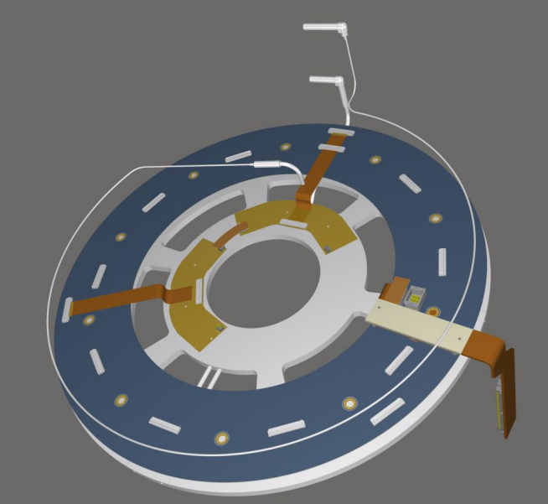
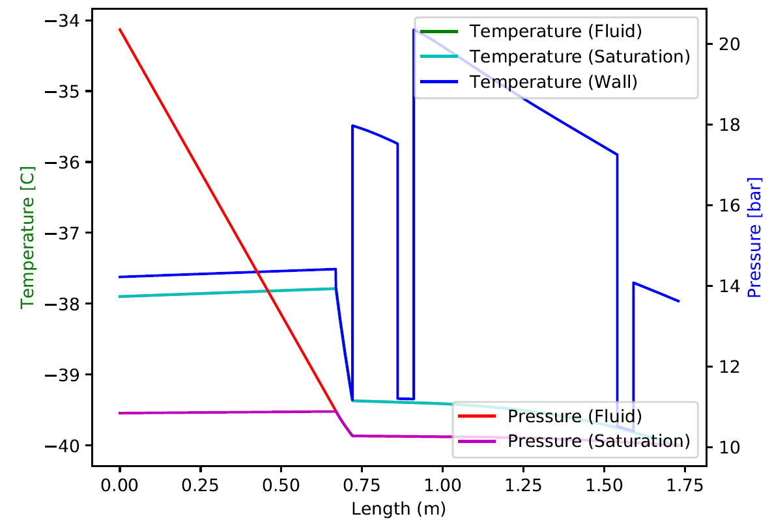
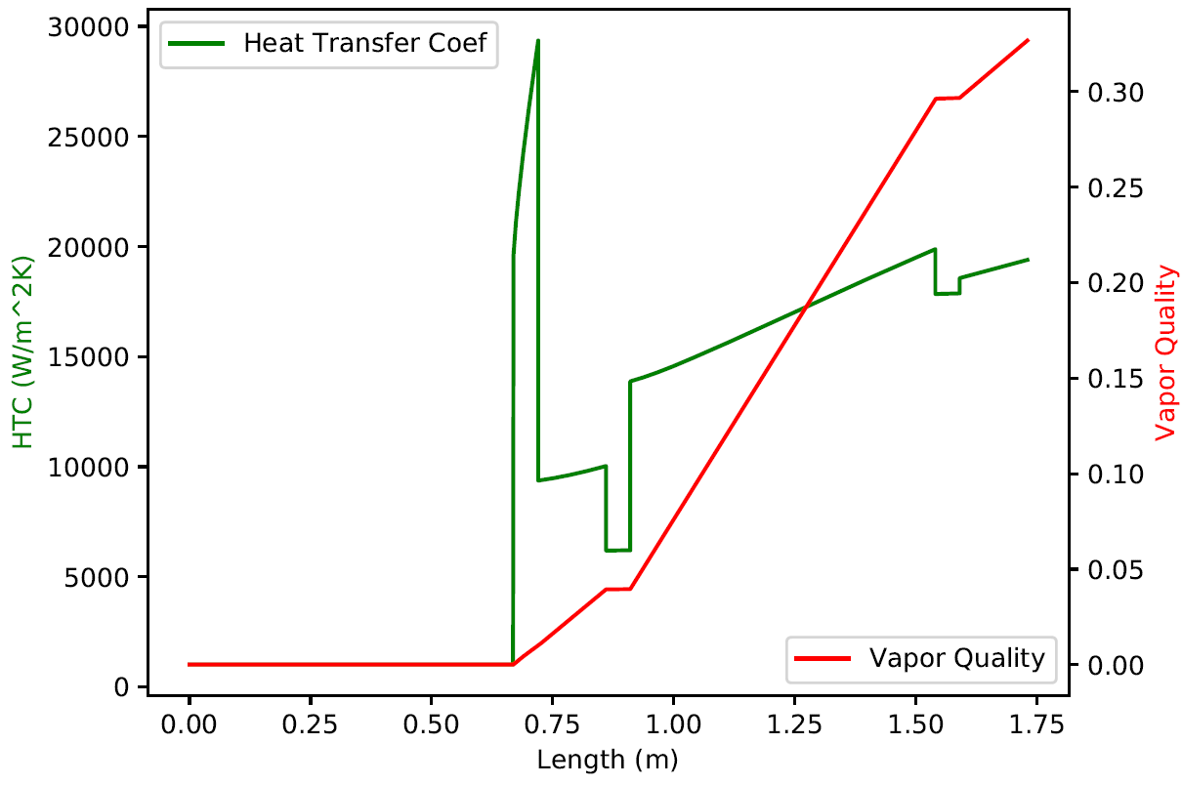
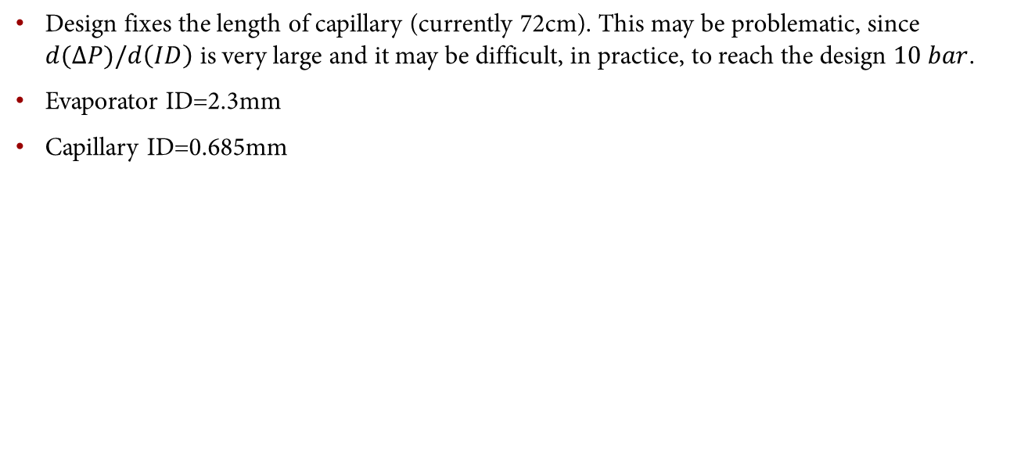
Endcap R0/1
Design fixes the length of capillary (currently 72cm). This may be problematic, since $d(ΔP)/d\left(ID\right)$ is very large and it may be difficult, in practice, to reach the design $10 bar$.
Evaporator ID=2.3mm
Capillary ID=0.685mm

Slide 6
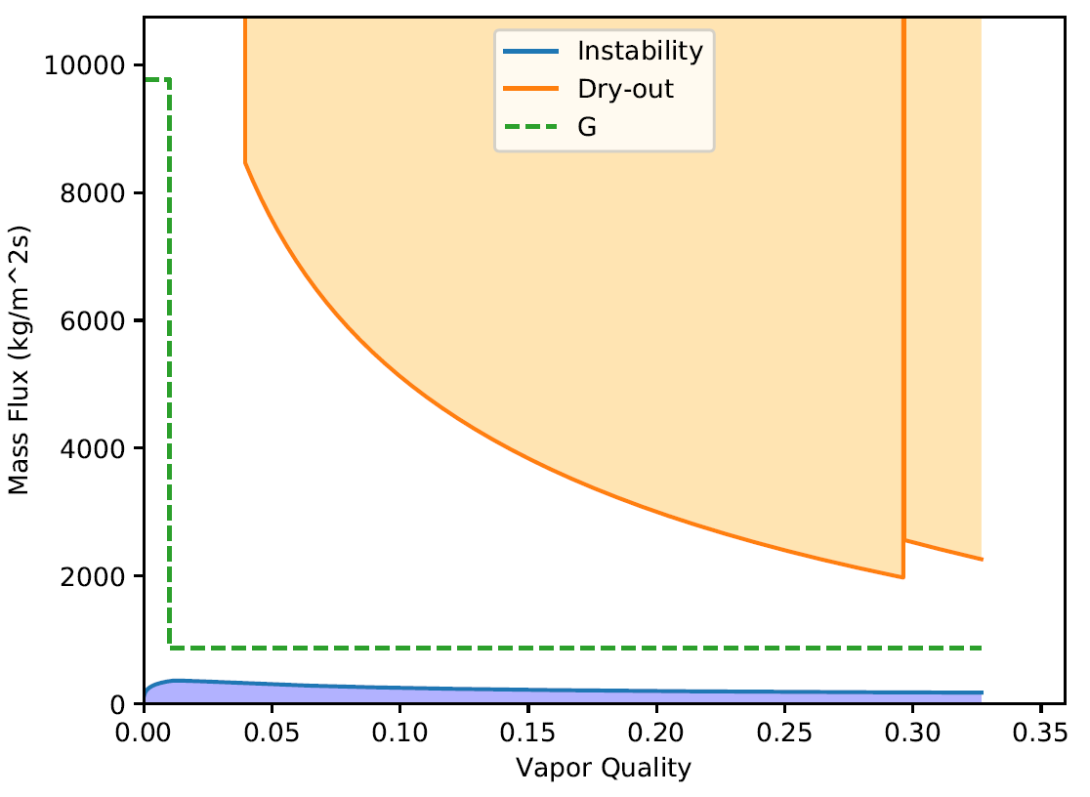
Endcap R0/1
Design fixes the length of capillary (currently 72cm). This may be problematic, since $d(ΔP)/d\left(ID\right)$ is very large and it may be difficult, in practice, to reach the design $10 bar$.
Evaporator ID=2.3mm
Capillary ID=0.685mm

Slide 7
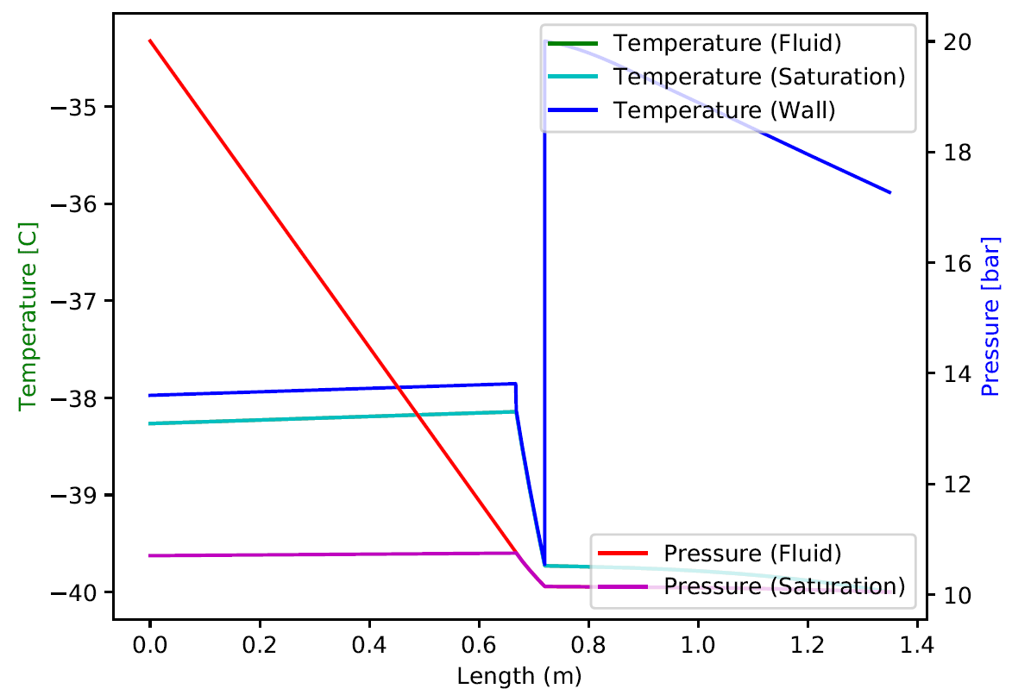
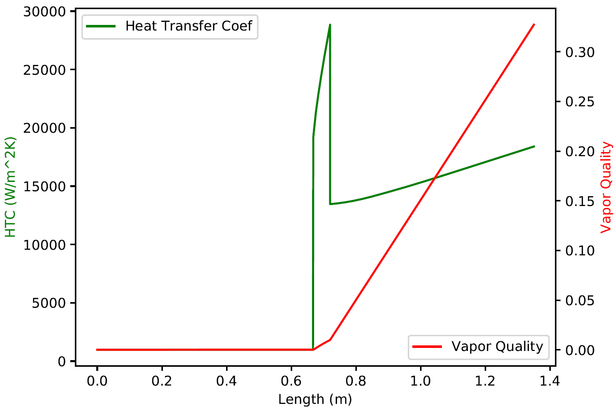
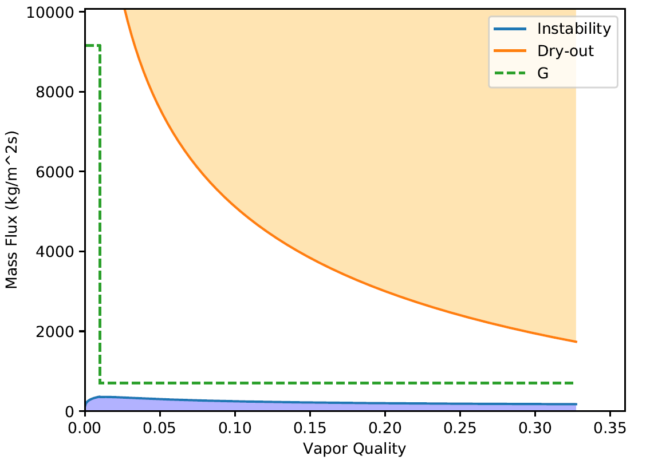

Endcap R1
Design fixes the length of capillary (currently 72cm). This may be problematic, since $d(ΔP)/d\left(ID\right)$ is very large and it may be difficult, in practice, to reach the design $10 bar$.
Evaporator ID=2.3mm
Capillary ID=0.635mm

Slide 8
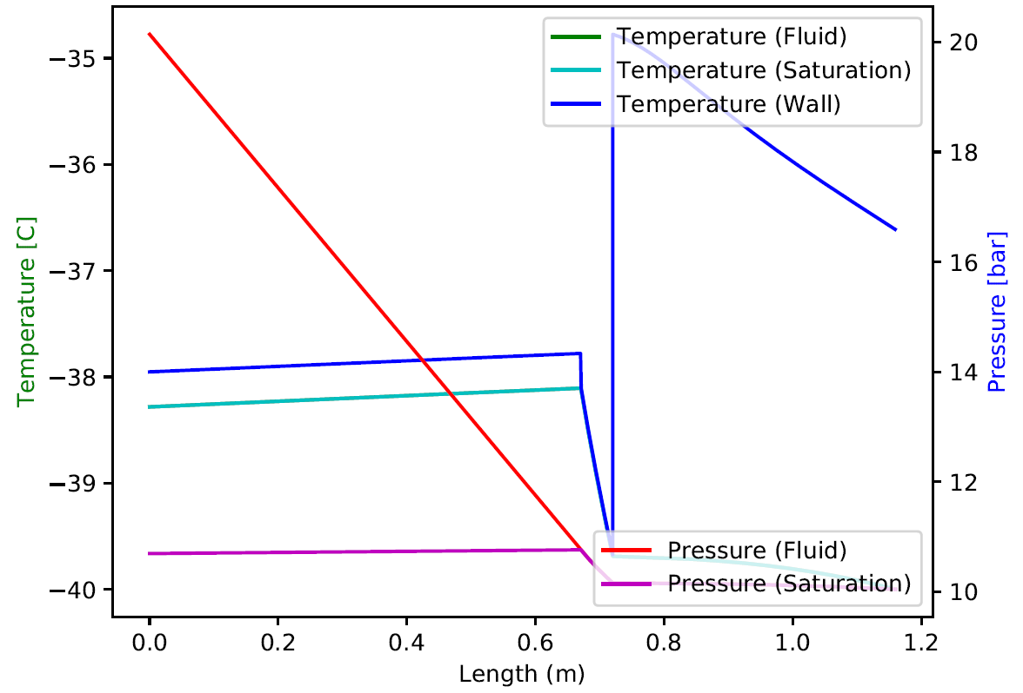
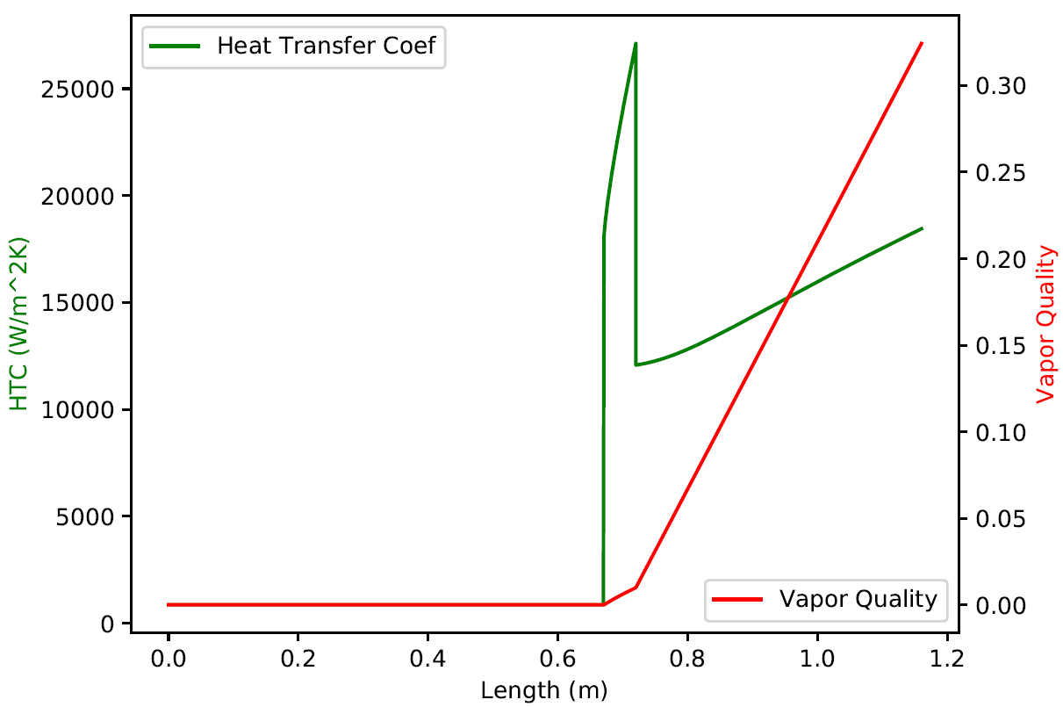
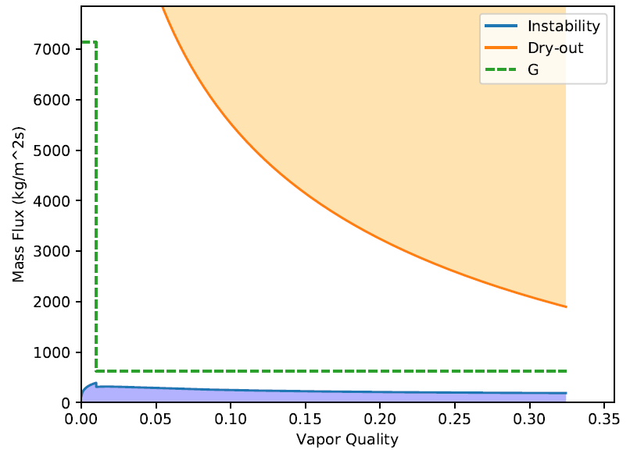
Endcap R0.5
Again, length of capillary fixed by design (72cm). It would be good to have some room for design.
The coolant mass flow is very different. For instance 1.1g/s here against 3.6g/s in the R0/1. This is also not ideal for manifolding.
Evaporator of ID=2.3mm does not work. Too big, creates unstable flow. Here we use evaporator ID=1.5mm and calculate a capillary with ID=0.443mm

Slide 9
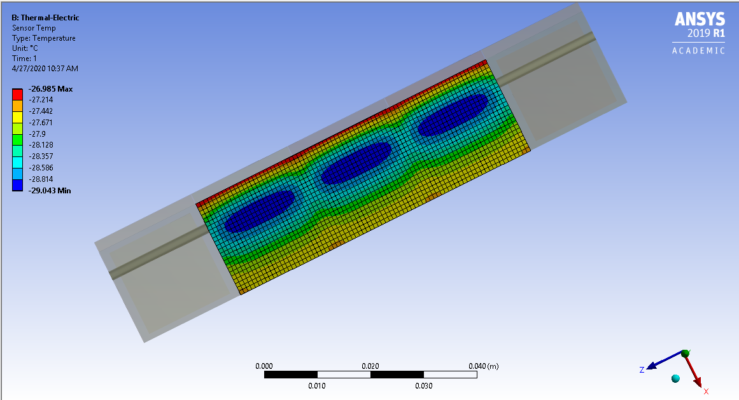
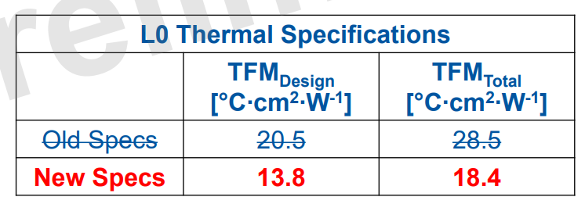
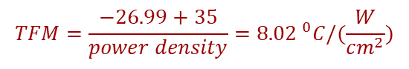
L0 simulation at smaller radius
Quick check of L0 condition at smaller radius (R=34mm)
Updated bias voltage and heat dissipation for 3D sensor at fluence of 1e16 neq/cm2 (design fluence is 1.86e16 neq/cm2, so this is slightly “optimistic” compared to end-of-life)
This is very preliminary. A complete re-run of the FEA is being performed. But I was asked to provide some partial feedback.
$$TFM=\frac{−26.99+35}{power density}={8.02 }^{0}C/(\frac{W}{cm^{2}})$$
Pessimistic HTC
Pessimistic glue coverage
Pessimistic foam thermal conductivity

Slide 10
Some quick plots
Again, I change HTC but do not iterate with thermo-fluidic simulation (yet)
L0 stave, as before, is very far away from runaway.
If (max) current has to be kept below 10nA, we need T < -23oC
For FE temp below -10oC, we need T < -19oC.

Slide 11
It looks ok…
But this is very preliminary, take with grain of salt.
A complete study will be ready soon.

